Slide 1
EDA I – Part 1
O’Neal Gray, David Laurel
DS 6306-401 – Doing Data Science
February 21, 2023

Slide 2
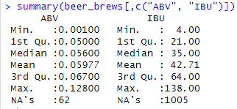
Dealing with Missing Values
Quickly determined ABV and IBU to have missing data
Based on this, we decided to fill in ABV data first, as this held a smaller missing dataset, then IBU with predictive- mean imputation since the missing data looks like MAR
Using the mice package, we’re able to do multivariate imputations, but we weren’t sure how to specify ABV as a predictor for IBU or vice versa, given their correlated status

Slide 3
Maximum ABV
We could quickly calculate the maximum ABV value with the given data, but there appeared to be more to the story than simple maximums
We calculated the five states with the highest scoring ABV beers pretty simply from the incomplete, original data (to make sure no made-up data was counted), as there was only one repeat (CO) in the top six candidates:
From here, we determined that the beer with the greatest Alcohol by Volume was Colorado’s "Lee Hill Series Vol. 5 - Belgian Style Quadrupel Ale"

Slide 4
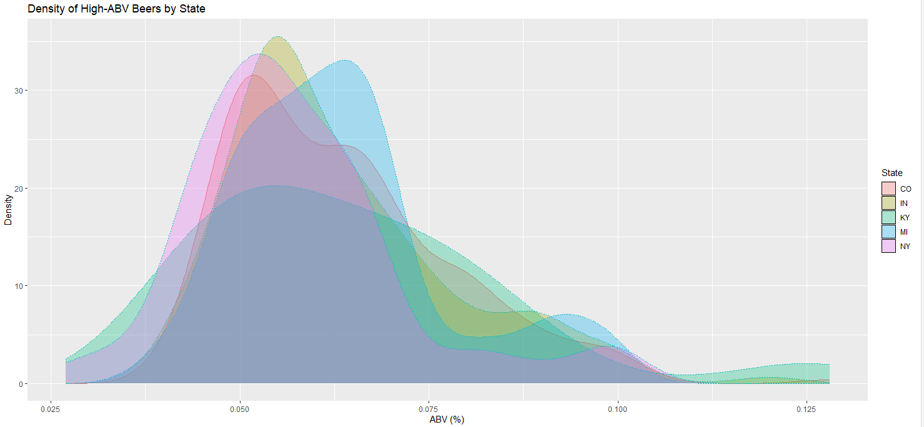
Maximum ABV (cont.)
However, when we attempted to see the distribution of ABV by state, Kentucky had significantly more beers at the top end of the distribution than any of the other states in the top five:

Slide 5
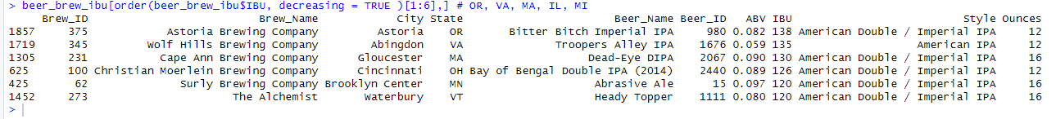
Maximum IBU
A similar story could be told with IBU, however, the missing data would be more significant in this instance:
The highest ranking IBU beer was aptly titled, “Bitter Bitch Imperial IPA” from Oregon

Slide 6
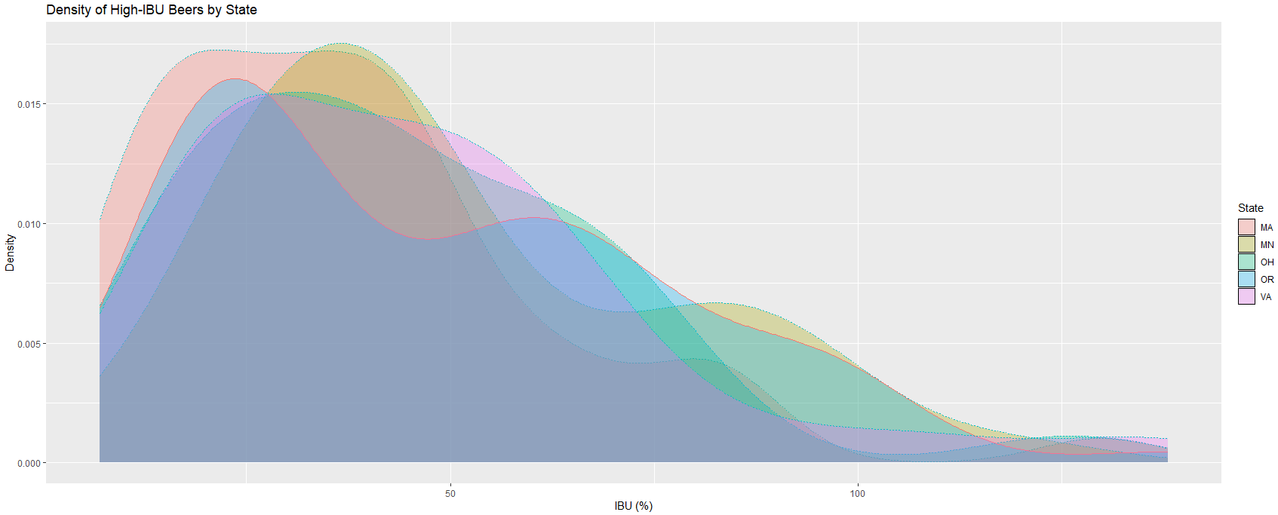
Maximum IBU (cont.)
Again, we see a disparity between density of beers-per-state at the high-end of the IBU spectrum, and the state with the winning IBU beer:

Slide 7
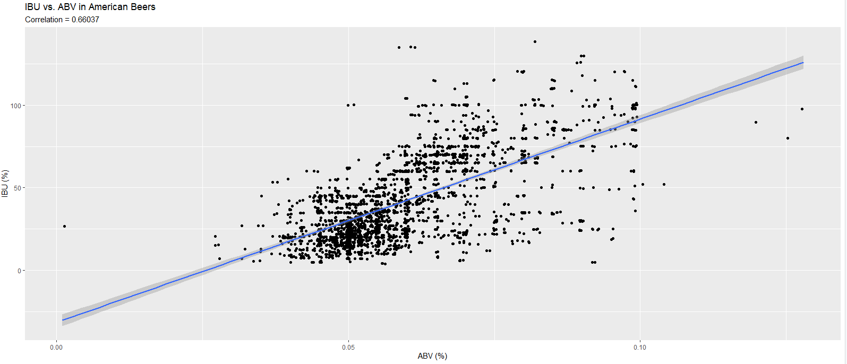
ABV/IBU Compared
There is a clear relationship between ABV and IBU as noted earlier
This relationship could assist in imputing missing column value in either column:

Slide 8
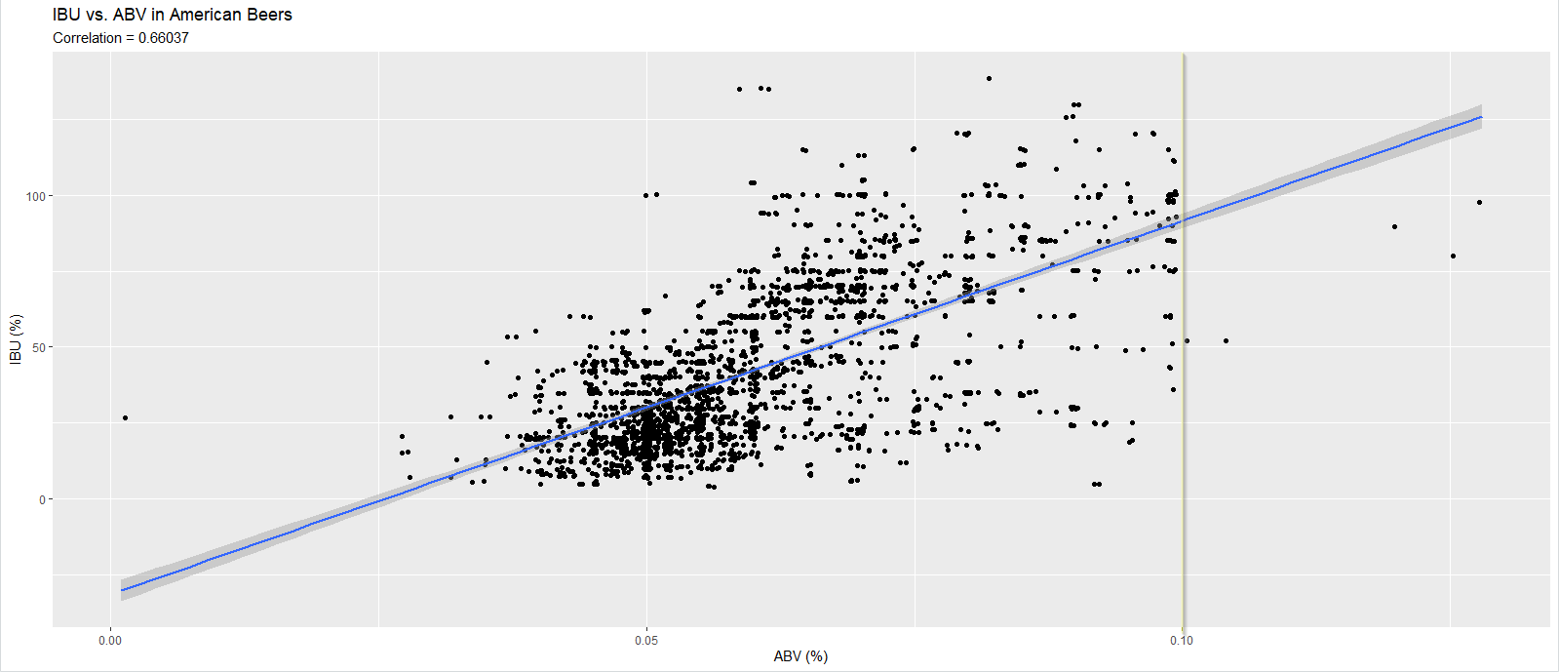
ABV/IBU Compared (cont.)
Interestingly, we see a wall at ABV=10%, where many states have historically set boundaries¹ on sales and distribution for higher alcohol-content beverages:

Slide 9
References
https://reason.com/2021/09/20/why-is-this-beer-banned-in-15-states/

